Slide 1


Slide 2



Table of Contents
This document contains the following resources:
Monitoring Environment
Splunk
Attack Analysis
Windows Logs
Apache Logs
Project Summary & Future Mitigations
Notes:
Table of Contents as you can see
Monitoring Environment 2. Attack Analysis 3. Project Summary & Future Mitigations (Slide)

Slide 3

Monitoring Environment
‹#›
Notes:
Splunk monitoring and searching through large data.It indexes and correlates information in a container that makes it searchable,and makes it possible to generate alerts,reports and visualization.(slide)

Slide 4



Scenario
Company: Virtual Space Industries (VSI)
Role: SOC analyst
Industry: Virtual Reality Program Design for Businesses
Threat: Rumors of cyberattacks from competitor JobeCorp
Monitoring Tool: Splunk
Monitoring Focus: Detect and prevent potential cyberattacks
Systems Analyzed:
Apache Web Server
Windows Server System
Notes:
In this scenario we play a role as a Soc analyst ,our company Virtual Space Industries has recently experience several cybersecurity attacks,likely from a competitor JobeCorp.The attack targeted several systems especially Windows and Apache servers. (slide)

Slide 5

Departures Board Visualization
‹#›
Notes:
add-on application we chose (above)

Slide 6
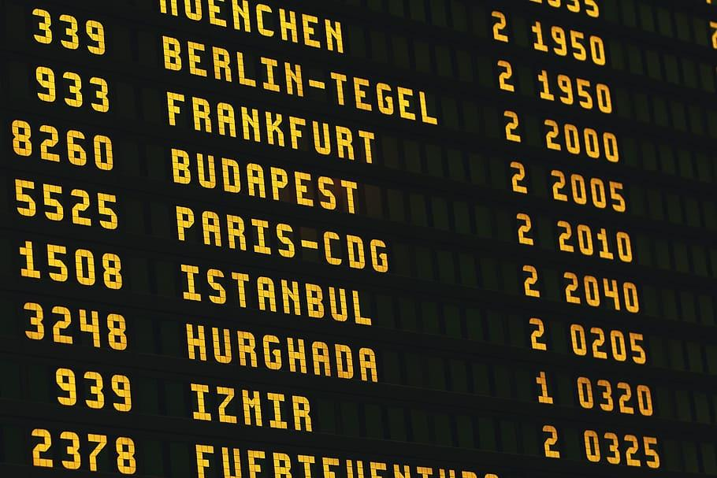
Departures Board Visualization
This app provides a visualization that you can use in our own apps and dashboards to display for numbers, time stamps, or any other important information in a fun way.
This visualization typically mimics the information boards you might find at airports or train stations, displaying real-time or scheduled departures and arrivals.
Notes:
read top point (slide)

Slide 7
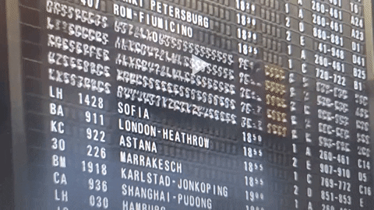
Departures Board Visualization
Scenario - Airport Departure Monitoring
Imagine you work at a busy airport as part of the operations team responsible for ensuring smooth departure and minimizing delays.Your team relies on Splunk for monitoring various operational data streams,including flight schedules,gate assignments,and real-time flight status updates.This helps you make better decisions and keep track of what's happening with flights and gates
Notes:
In this scenario,the departure board visualization add-on enhances the airport operational efficiency by providing real time,centralized ,and visually intuitive way to monitor departures. It streamlines gate management,communication with passengers ,and decision-making,ultimately contributing to a smother airport experience.
This is an example of a real departure board. In the scenario above (slide)

Slide 8
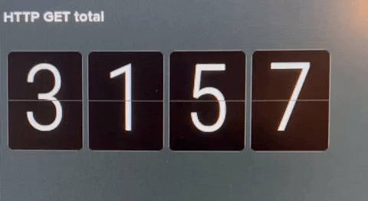
Departures Board Visualization
Add-on App Benefits:
Real-Time “Flight” Status
Centralized Information Easy to Read
Visual Prioritization
Mobile Access
Reduced Manual Effort
Customization
Stimulus for the analyst - reducing viewer fatigue
Notes:
Visual of how it works/Read the benefits

Slide 9
Logs Analyzed
Windows Logs
Apache Logs
1
2
Contains information about the upcoming VR programs Informations includes:-
Status of the activity
Severity levels
All the account deleted
Frequency of the logins
Contains information about the public website
Information includes:-
IP address of the client
Site Domain
HTTP methods
Notes:
Logs Analyzed - Windows and Apache Logs
Hand it over to Henry to provide more details

Slide 10
Windows Logs
‹#›
Notes:
Thanks so much Viktoria. The next section involves Windows logs we uploaded into splunk. next slide please,

Slide 11
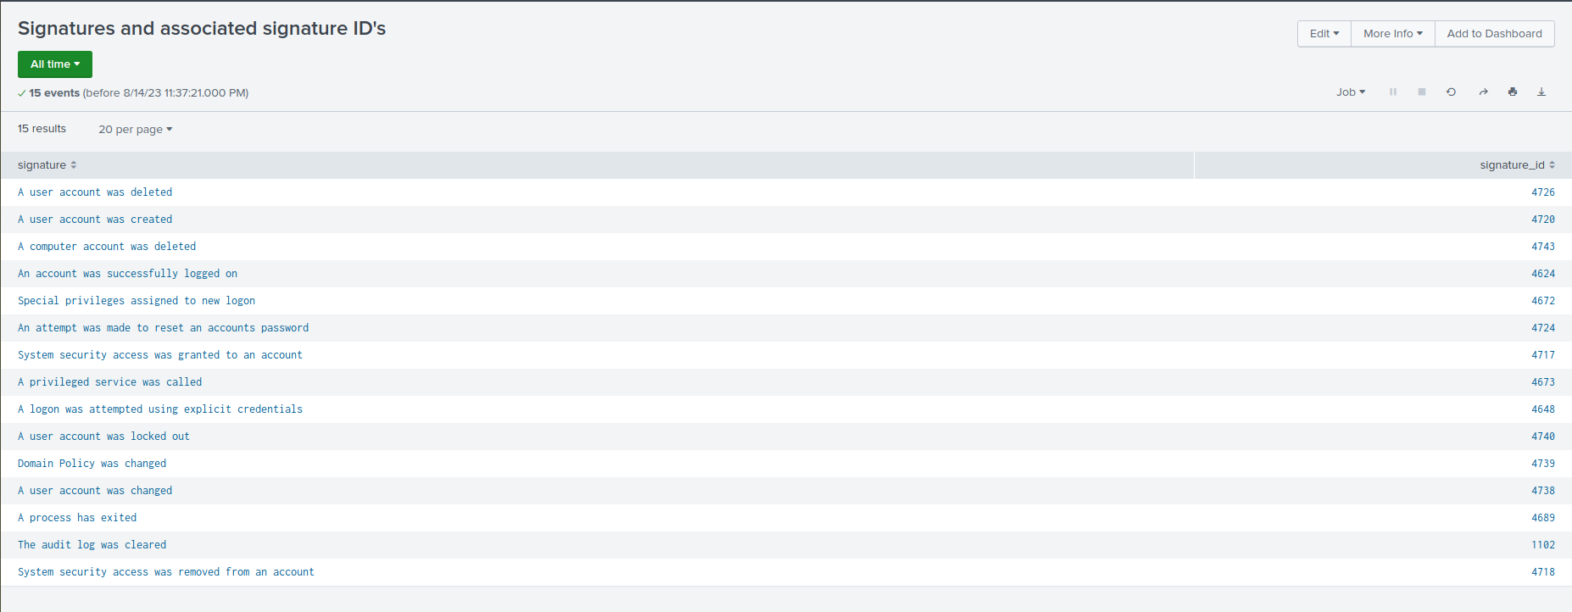
Reports—Windows
Report Name | Report Description
Signatures and associated signature ID’s | This report illustrates the windows security activity log events ( Patterns of activity or code corresponding to processes) and the signature ID code.
Notes:
The first report we made is called signatures and associated ID’s. This report illustrates the windows security activity log events whereby signatures are the patterns of activity corresponding to signature code ID number as shown. Slide please

Slide 12
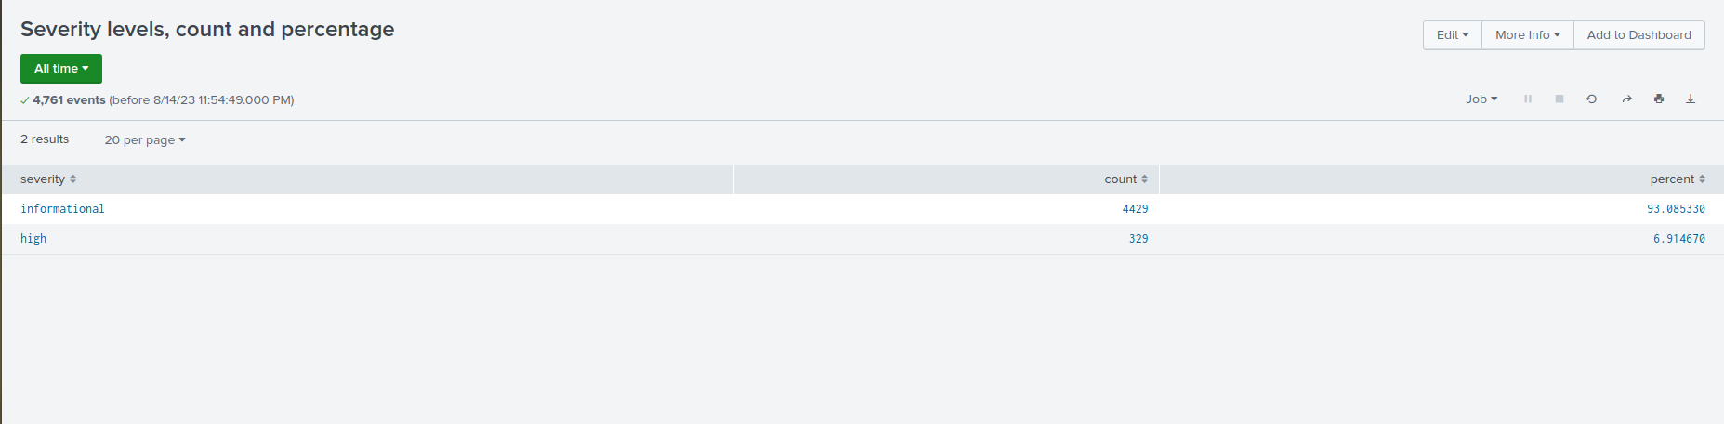
Reports—Windows
Report Name | Report Description
Severity levels, count and percentage | This report provides an overview of count and percentage of severity levels.
Notes:
The next report we created was Severity levels which provides an overview of count and % of the scale of severity. Noting that approx 7% of activity is deemed as high. Slide please.

Slide 13
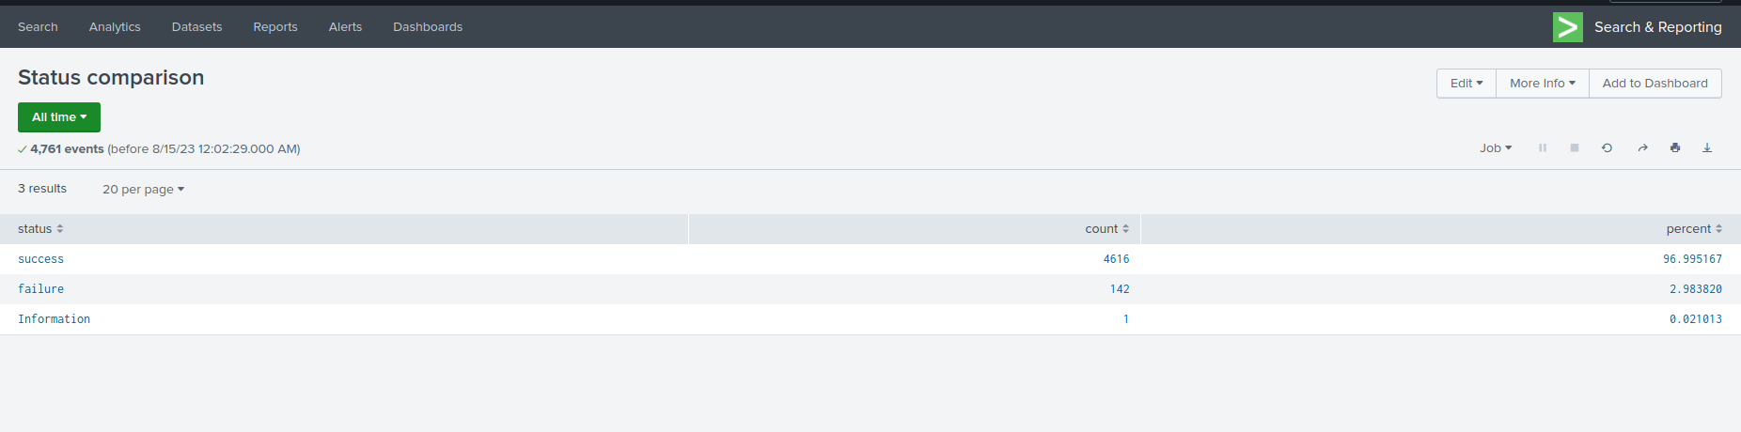
Reports—Windows
Report Name | Report Description
Status comparison | This report displays the count and percentage of the activity status.
Notes:
The 3rd report was the Status Comparison. Here the count and percentage of successful and failed activity is displayed. Moving onto the next section of Alerts. Slide please.

Slide 14
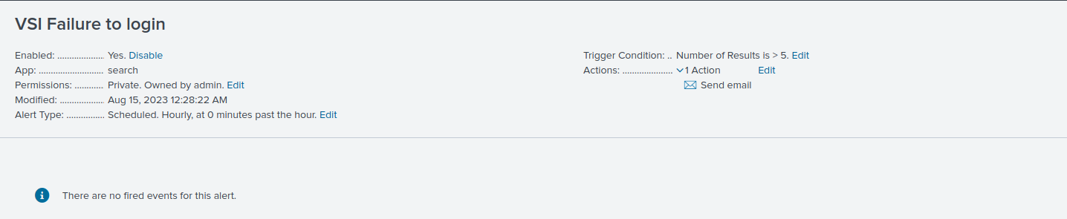
Alerts—Windows
Designed the following alerts:
Alert Name | Alert Description | Alert Baseline | Alert Threshold
VSI Failure to login | Threshold and Baseline of failed windows activity for hourly level | 2 | 5
JUSTIFICATION:
Baseline: Expectation is to have at least 2 failed logins per hour Threshold: Exceeding more than 5 failures, would trigger an alert
Notes:
The first alert we created was Failure to Login. The alert baseline was determined to be 2 per hour and we set the Alert threshold or minimum number that will trigger an alert to 5 failed logins per hour. Next slide please.

Slide 15
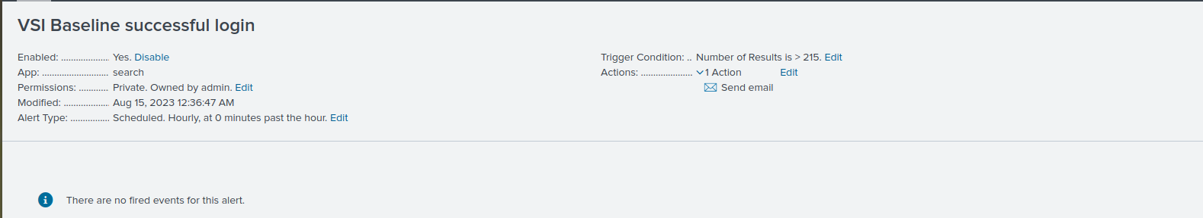
Alerts—Windows
Designed the following alerts:
Alert Name | Alert Description | Alert Baseline | Alert Threshold
VSI Baseline successful login | Threshold and Baseline for the hourly count of Signature ID :- | 154 | 215
JUSTIFICATION: Baseline : Expected between 154 - 200 successful logins per hour Threshold : Exceeding more than 215 successful logins, would trigger an alert
Notes:
The next alert we created was that for Successful Logins per hour. Since our Alert baseline was determined to be 154, we set the alert threshold to 215. Next slide please.
@ Henry: the justification is there. If there are questions, we go to our resident expert Mel at the end. totally makes sense here Mel no worries!

Slide 16
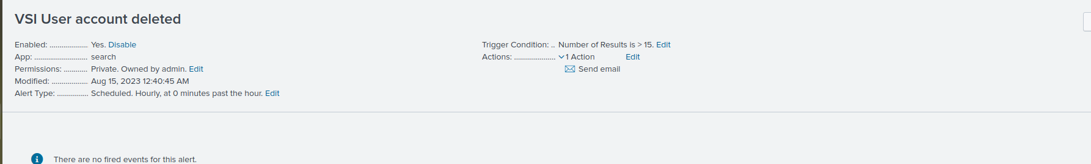
Alerts—Windows
Designed the following alerts:
Alert Name | Alert Description | Alert Baseline | Alert Threshold
VSI User account deleted | [Threshold and Baseline for the hourly count of the Signature Id ] | 10 | 15
JUSTIFICATION: Baseline: the lowest number of account deleted in the non-attack data was 10 Threshold: Exceeding more than 15 user account deleted, would trigger an alert.
Notes:
THe next alert was for User accounts deleted for which we determined the alert baseline and threshold per hour as shown. The following section depicts our visualization reports. Next slide please.

Slide 17
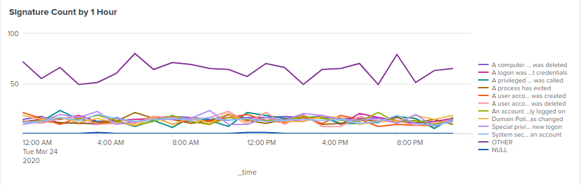
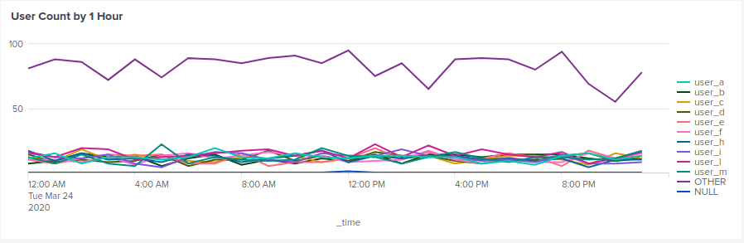
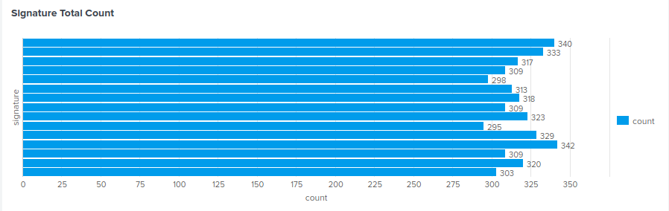
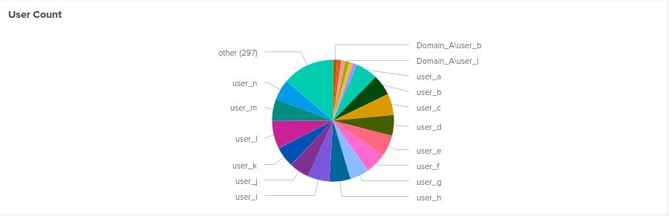
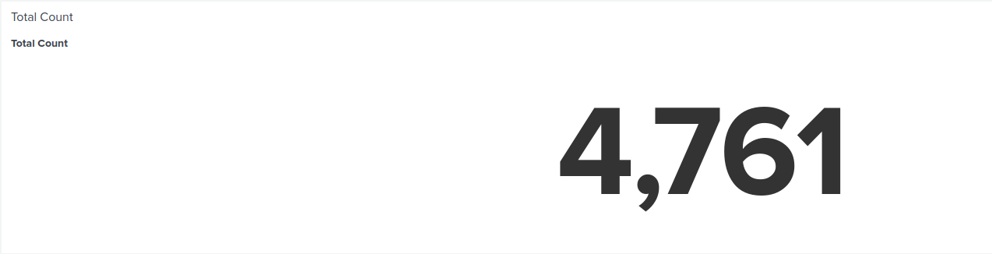
Dashboards—Windows
Place image here
Place image here
Notes:
Here we have created a bar chart on top left showing signature count, beside it user count. the bottom left depicts a bar graph of Signature count totals and finally a delicious pie chart showing the user counts all by hourly increments. The next section involves using the Apache server logs we uploaded into splunk.
Next slide please.

Slide 18
Apache Logs
‹#›

Slide 19
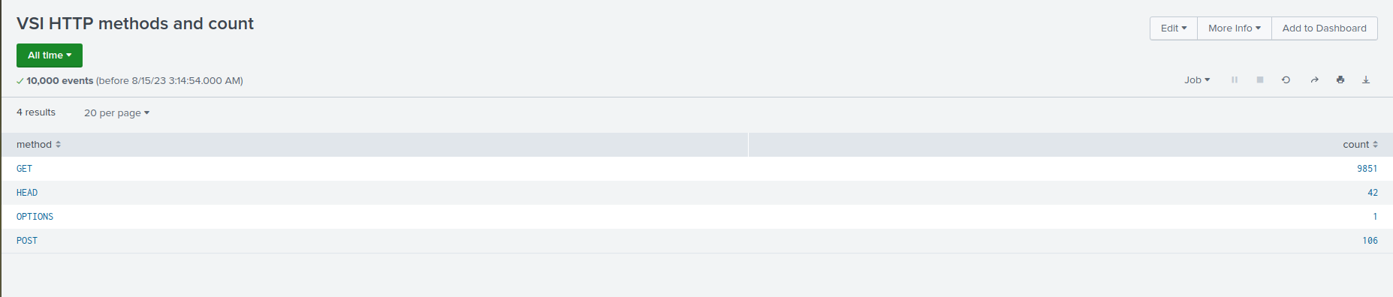
Reports—Apache
Designed the following reports:
Report Name | Report Description
VSI HTTP methods and count | Table of different HTTP methods used
Notes:
Here we created report showing VSI’s HTTP Methods and specific Count of GET (GRAB DATA), HEAD (GRAB DATA WITHOUT RESPONSE BODY), OPTIONS (OBTAIN HTTP OPTIONS FROM SERVER B4 SENDING HTTP REQUEST) AND POST REQUESTS (SAME AS GET BUT SAFER -PARAMETERS ARE NOT STORED IN YOUR BROWSER HISTORY OR IN WEB SERVER LOGS - LONGER REQUEST THOUGH, MAX 2048 CHARACTERS)

Slide 20
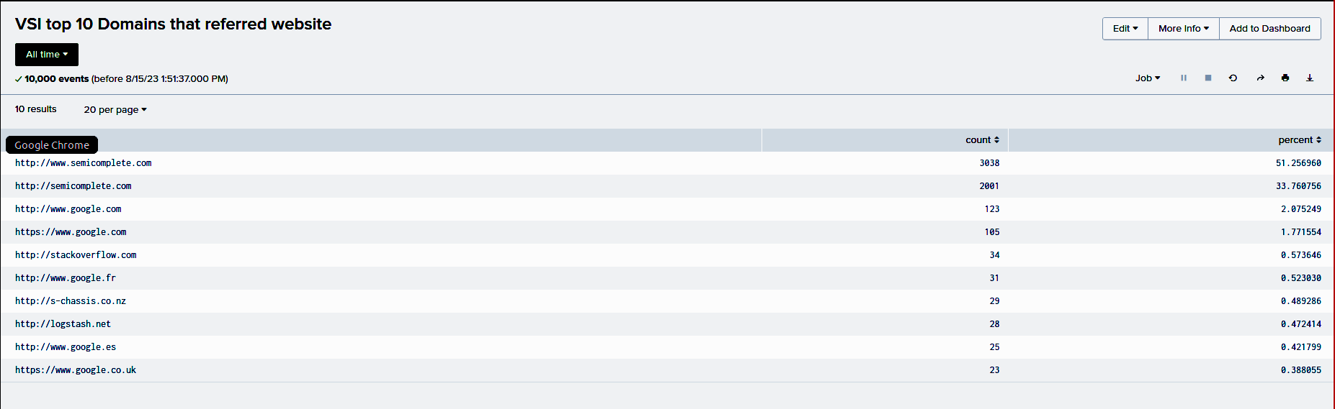
Reports—Apache
Report Name | Report Description
VSI top 10 Domains that referred websites | Top 10 referred domain website
VSI count of each HTTP response code
Table and coun
Notes:
The next report was created to list the top 10 domains that referred websites with the results as shown. Next slide please

Slide 21
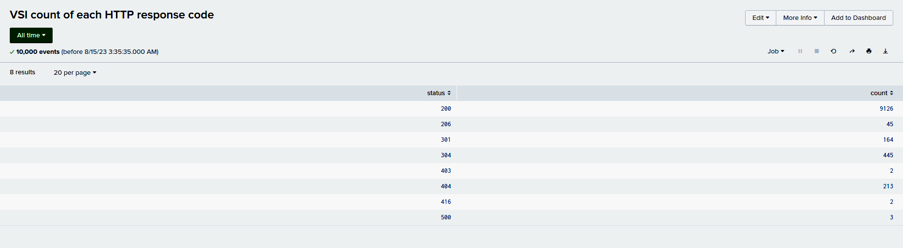
Images of Reports—Apache
Report Name | Report Description
VSI count of each HTTP response code | Table and count of HTTP response code
Notes:
This last report is the count of HTTP response codes as shown. The next section is alerts for APACHE servers. Next slide please

Slide 22
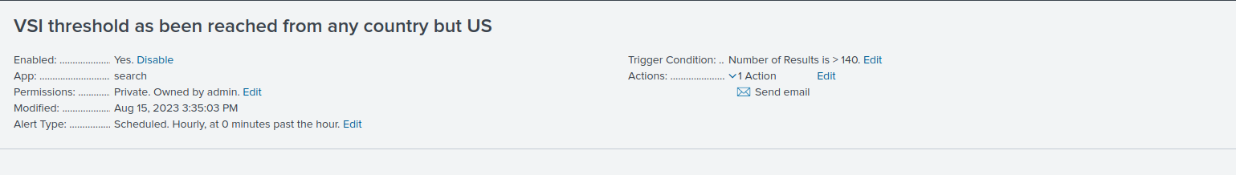
Alerts—Apache
Designed the following alerts:
Alert Name | Alert Description | Alert Baseline | Alert Threshold
VSI threshold has been reached from any country but US | Baseline and Threshold is determined for hourly activity from any country besides USA | 112 | 140
JUSTIFICATION: Baseline : Expect at least 80-112 count international use per hour
Threshold: Exceeding 140 transactions per hour would raise suspicions , given that our usual range is 80 - 112
Notes:
The first alert is for VSI’s Threshhold for countries (excluding United States) The baseline and alert threshold are as depicted.

Slide 23
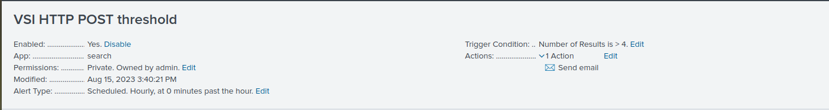
Alerts—Apache
Designed the following alerts:
Alert Name | Alert Description | Alert Baseline | Alert Threshold
VSI HTTP POST threshold | Determine an appropriate threshold and baseline of the HTTP Post Method for hourly count | 2 | 4
JUSTIFICATION: Baseline: We expected between 0-3 events per hour.
Threshold: Exceeding more than 4 POST usage , would trigger suspicion
Notes:
The next alert is the hourly HTTP POST threshold with a baseline of 2 and alert threshold of 4. The next section we created charts on our dashboard. Next slide please.

Slide 24
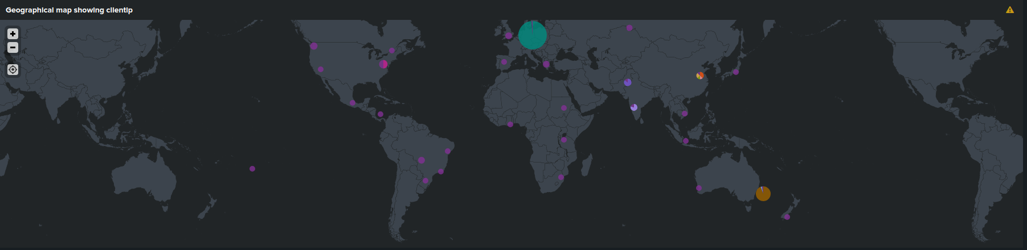
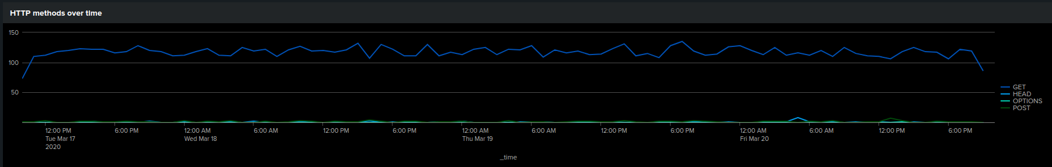
Dashboards—Apache
Notes:
The top portion depicts the Geographical map showing client ip throughout the world.
The Bottom shows the HTTP methods over time. NExt slide please.

Slide 25
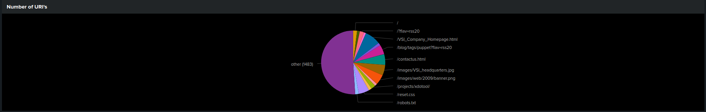
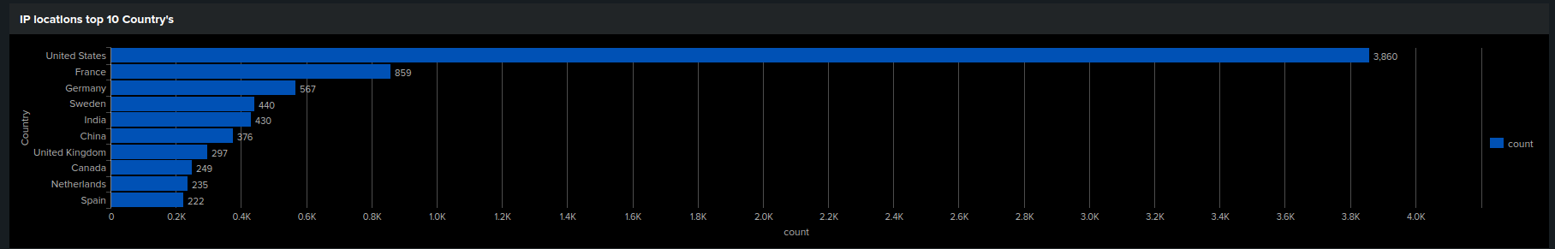
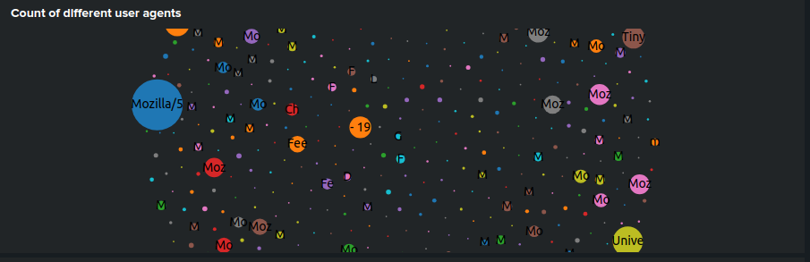
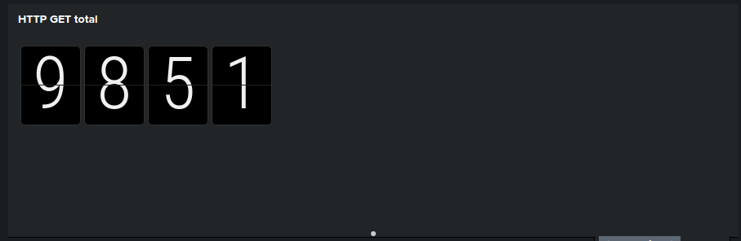
Dashboards—Apache
Notes:
Lastly these Charts on our dashboard include a pie chart depicting the Number of URI’s
IP locations top 10 country’s
Count of different user agents and lastly single point HTTP GET total DEPARTURE BOARD visualization. Here is David with our interpretations.

Slide 26
Attack Analysis
‹#›
Notes:
thank you henry, my name is david, im here to take you throught attack analysis

Slide 27
Attack Summary—Windows
Summary of findings from our Reports and Alerts when analyzing the attack logs:
Failed Activity Report
Failed Window Activity Alert
Various Time Threshold Results
Successful Logins & suspicious volumes of successful logins detected
Deleted Accounts
Time Chart of Signatures & Users
Notes:
the windows attack summary, reports and alerts for the following activities:
(Read the bullet points )

Slide 28


Attack Summary—Windows
Alert threshold summary:
Alert Analysis for Failed Window Activity
Alert Analysis for Successful Logins
Alert Analysis for Deleted Accounts
Notes:
our attack thresholds were mainly successful
alert analyst for failed window activity .
we needed to increase our threshold from 5 to 12
alert analysis for successful logins was set at 215
alert analysis for deleted accounts was set at 15

Slide 29

Attack Summary—Windows
Our Splunk Dashboards utilizing our new apps revealed the following:
March 25, 2020
User_a
From 12 am - 3pm User account was locked out with 984 attempts made at the peak time of 1am
User_k
From 8am - 11am an attempt was made to reset password with 1258 attempts made at the peak time of 9am
User_j
From 10am - 1pm an account was successfully logged on with 196 attempts made at the peak time of 11am
Notes:
Read the slide

Slide 30
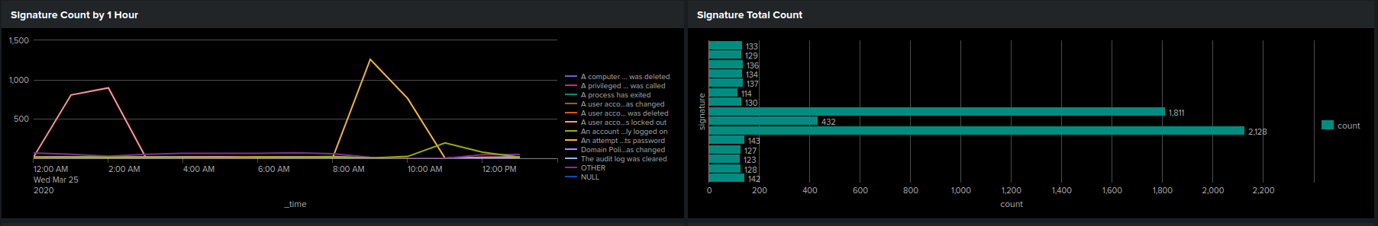
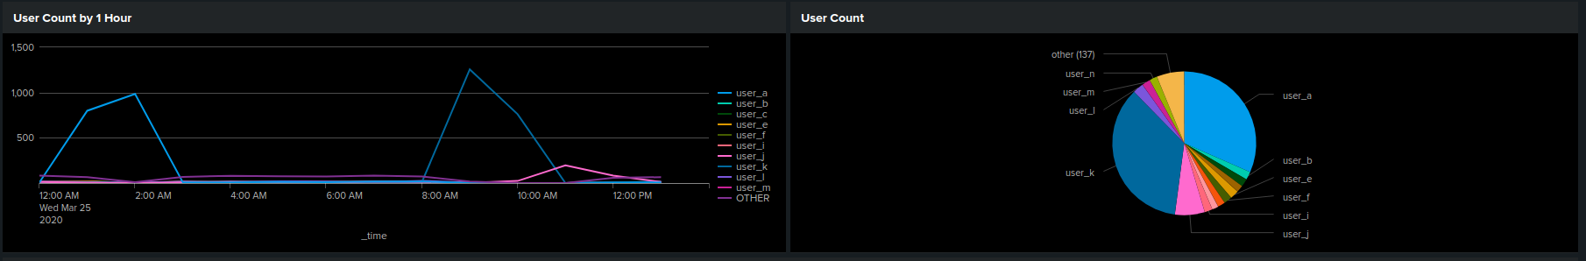
Screenshots of Attack Logs
Notes:
this illustration shows what i've mentioned on the previous slide

Slide 31



Attack Summary—Apache
Summarize your findings from your reports when analyzing the attack logs.
Our analysis found the following on the Apache Web Server Log:
Suspicious changes in Referrer Domains
Decreased 77.6%
Suspicious changes in HTTP Response Codes
Response Code 404 Increase 15%
Notes:
originally had 6437 events and was then reduced to 1442 events

Slide 32

Attack Summary—Apache
Summarize your findings from your reports when analyzing the attack logs.
Our analysis also found the following on the Apache Web Server Log:
Suspicious changes in HTTP POST
Increased 1324%
Notes:
we going to continue with the apache attack summary
(read slide)
POST increase from 100 to 1324 counts. that is an increase of 1324%
This suspicious volume increase occurred on Mar. 25/2020 at 8pm with 1296 counts.
Our threshold is at 4 and the alert was immediately triggered.

Slide 33

Attack Summary—Apache
Summarize your findings from your alerts when analyzing the attack logs. Were the thresholds correct?
Our Analysis for International Activity
detected increase volume of activity from international countries.
Our thresholds is set to trigger an alert at 140 counts.
We noticed 730 counts at 6:00 pm and again at 8:00 pm with 1415 counts.
Notes:
(USA was excluded from these findings. )
As these spikes occurred our alerts were triggered and there is no need to set these alerts higher.

Slide 34
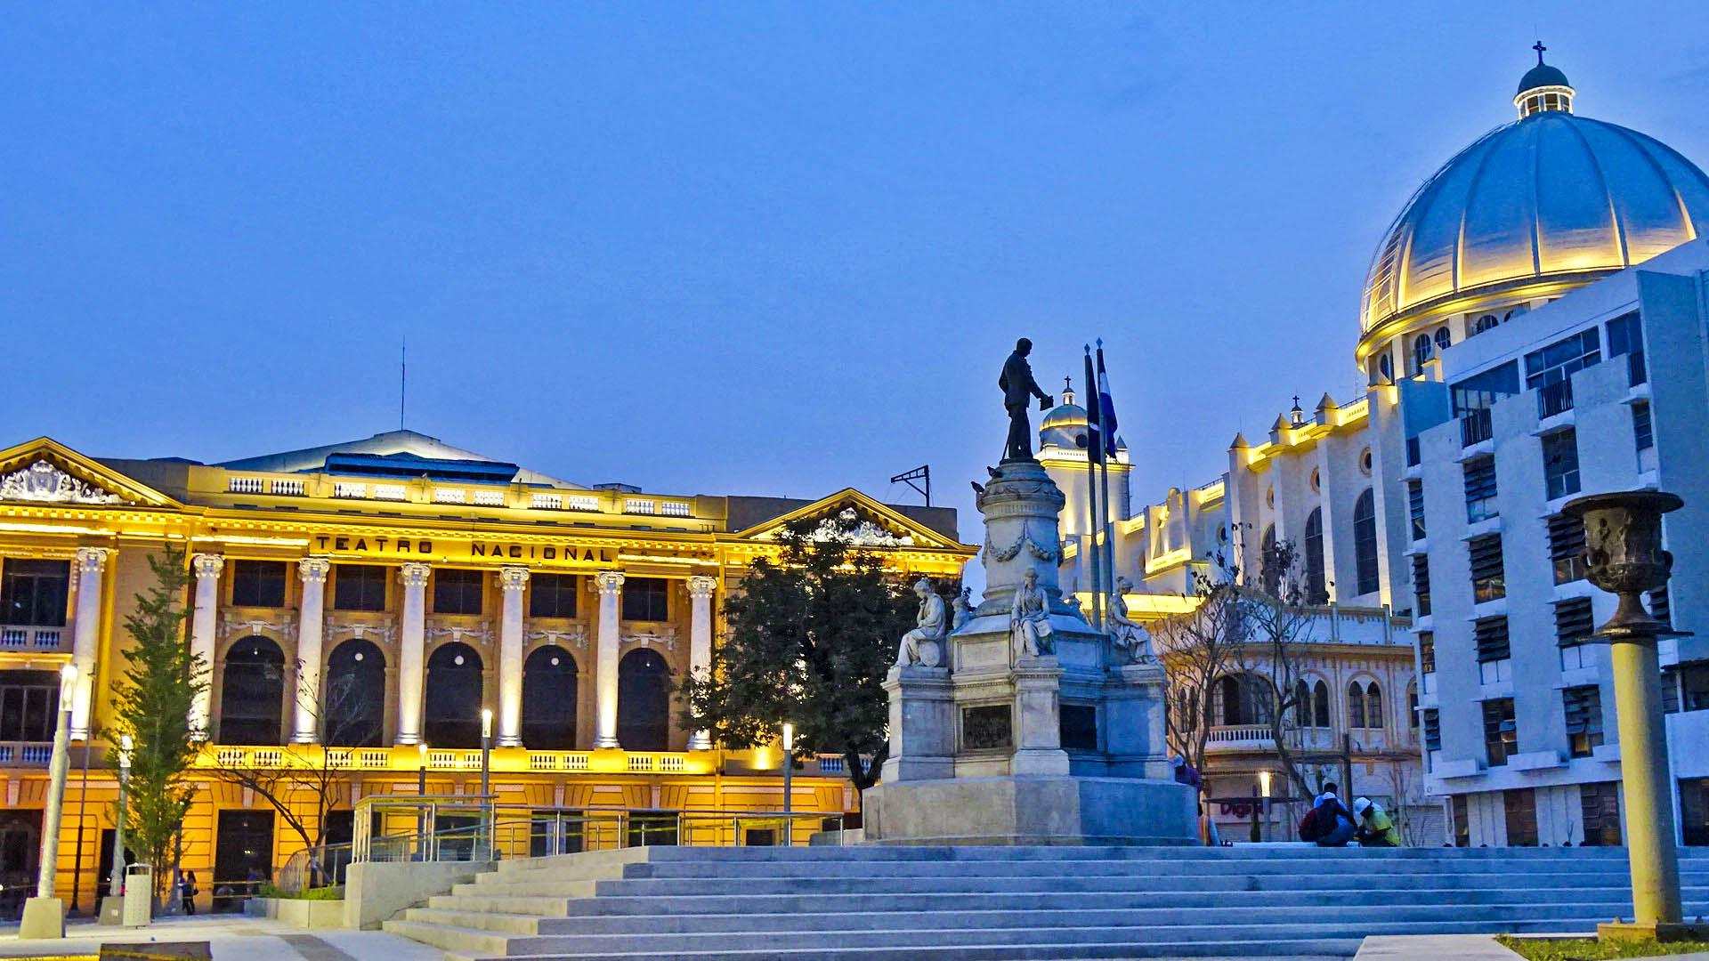


Attack Summary—Apache
Summarize your findings from your alerts when analyzing the attack logs. Were the thresholds correct?
Can you guess what cities in particular we noticed?
Summarize your findings from your alerts when analyzing the attack logs. Were the thresholds correct?
….stayed tuned and I will reveal all!
Notes:
read slide

Slide 35
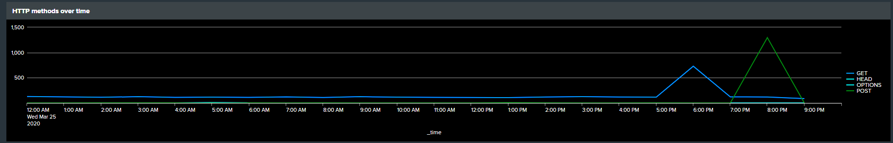
Attack Summary—Apache
Dashboard Analysis for Time Chart of HTTP Methods:
After analyzing the attack logs on the dashboard, we found POST and GET methods were used in this attack.
Notes:
we are continuing with our apache attack summary .
(read slide)
The GET attack occured from 5pm to 7pm and peaks at 6pm with 729 counts.
The POST attack occured from 7pm - 9pm and peaks at 8pm with 1296 counts.

Slide 36
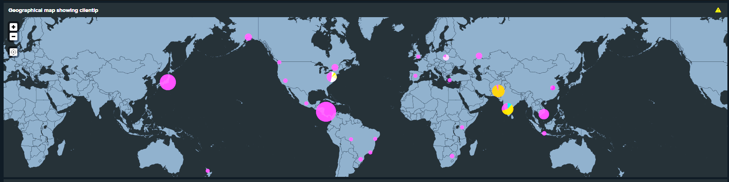
Attack Summary—Apache
Dashboard Analysis for Cluster Map revealed:
An increase of density change of a few countries. In particular: Japan, India, and El Salvadore.
After further analysis we found Ukraine with high volume of activity as well.
Notes:
(read slide from the green)
Remember those city shots from earlier….
Well. after diving into these countries we found Tokyo with 26 counts, New Delhi with 22 counts, and El Salvadore with 34 counts.

Slide 37
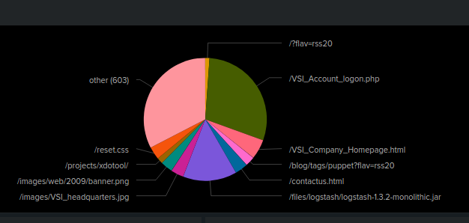

Attack Summary—Apache
Dashboard Analysis of URI Data revealed high activity on the logon.php page and on the files.logstach1.3.2 page.
What does this mean?
Notes:
Finally our Dashboard Analysis.
(read slide)
The attacker is potentially login onto the system and is collecting data and is piping information to them that they collected. This is realized by using pipelines, which contain input, filter and output modules. The service gets interesting when having a compromised a machine which is running Logstash as a service.

Slide 38
Summary and Future Mitigations
‹#›
Notes:
let me introduce Neal to rap up summary and future mitigations

Slide 39
VSI Analysis Summary
The analysis primarily relies on alert-triggering thresholds set during the attack.
Comparing Windows and Apache server logs with attack logs revealed a significant increase in severity component of signature IDs, indicating a 337% rise from 329 to 1111 counts in failed activity
Successful logins analysis showed suspicious patterns, and a user named "user_k" triggered an alert with 2114 logins at 9 am
Deleted accounts showed no significant deviation from baseline
Dashboard analysis of user signatures revealed suspicious activities related to password changes and account lockouts, particularly User_a and User_k
Dashboard analysis revealed suspicious activity related to POST and GET methods, indicating an attack
Foreign actor interaction was notable during specific times
Cluster map analysis pointed to origins in Japan, India, and El Salvador
URI analysis identified troubling logon.php activity and the presence of Logstash

Slide 40
Proposed Mitigations
Window Servers
Implement appropriate alerts more specific to both the Windows and Apache servers
Utilize Internet Information Services (IIS) URL or Rewrite module v2 installed on on the (Microsoft) Exchange Server to use Emergency Mitigation
Apache Servers
Use a mod_req timeout module on HTTP server

Slide 41

Proposed Mitigations
As for VSI specifically, once all is rectified with Jobecorp, by utilizing the services and skills of Glitch Goblin, there’s always another threat actor on the horizon…
… the job of a cybersecurity professional is never done.

Slide 42


